Slide 1
CS 4031 Compiler Construction Chapter 8
Faryal Saud
Lecturer, Department of Computer Science
FAST NUCES CFD

Slide 2
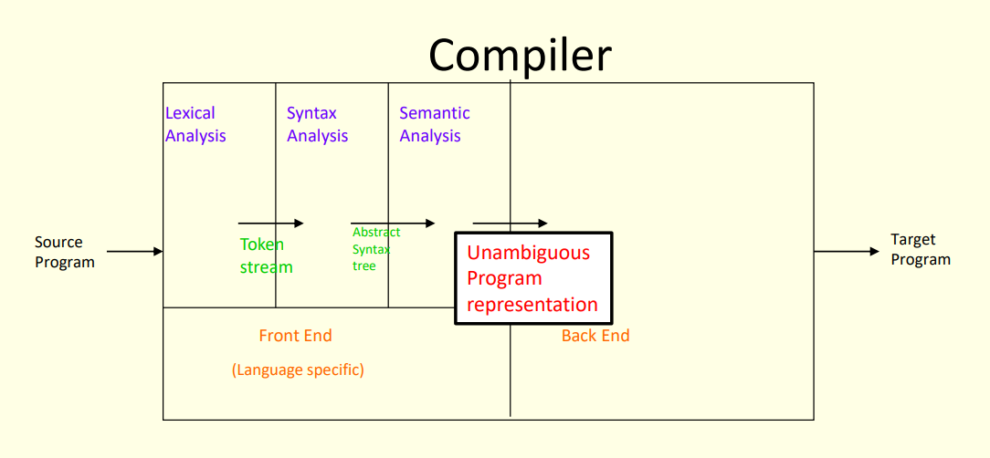
Intermediate Representation

Slide 3
Intermediate Code
Similar terms: Intermediate representation, intermediate language
Ties the front and back ends together
Language and Machine neutral
Many forms
Level depends on how being processed
More than one intermediate language may be used by a compiler

Slide 4
Intermediate Representation
More of a wizardry rather than science
Compiler commonly use 2-3 IRs
HIR (high level IR) preserves loop structure and array bounds
MIR (medium level IR)
reflects range of features in a set of source languages
language independent
good for code generation for one or more architectures
appropriate for most optimizations
LIR (low level IR) low level similar to the machines

Slide 5
Understanding Compiler Design
Source and Target Language
A compiler converts a source language (high-level code) into a target language (machine code).
Porting Cost and Reuse
Reusing an existing compiler design can save time and resources but may come with porting challenges (adjusting to a new system).
Optimization
Some compiler architectures allow more efficient code optimizations than others.

Slide 6
High Level IR
int f(int a, int b) {
int c;
c = a + 2;
print(b, c);
}
Abstract syntax tree
keeps enough information to reconstruct source form
keeps information about symbol table

Slide 7
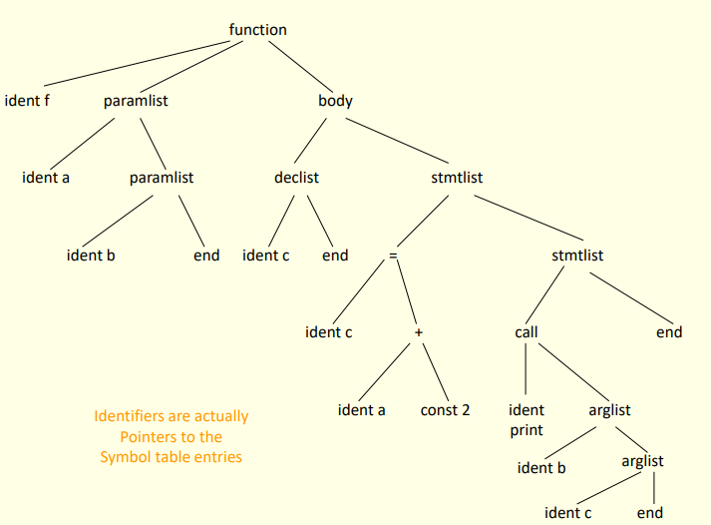
High Level IR

Slide 8
Medium Level IR
Medium level IR
reflects range of features in a set of source languages
language independent
good for code generation for a number of architectures
appropriate for most of the optimizations
normally three address code

Slide 9
Low Level IR
corresponds one to one to target machine instructions
architecture dependent

Slide 10
Intermediate Language
Intermediate code can be represented in the following four ways.
Syntax trees
Directed acyclic graph(DAG)
Postfix notation
Three address code

Slide 11
Three address Code
Three address code is a linear representation of a syntax tree or a DAG in which explicit names correspond to the interior nodes of the graph.
Three address code is a sequence of statements of the form A = B OP C where A, B and C are the names of variables, constants or the temporary variables generated by the compiler.
OP is any arithmetic operation or logical operation applied on the operands B and C.

Slide 12
Example
Consider the expression a + b * c;
this expression is expressed as follows:
T1 = b * c
T2 = a + T1
Here T1 and T2 are compiler-generated temporary names.

Slide 13
Example:
Generate the three address code for the following C statement
a = b* − (c − d) + b* − (c − d)
Solution:
T1 = c − d
T2 = −T1
T3 = b * T2
T4 = c − d
T5 = −T4
T6 = b * T5
T7 = T3 + T6
a = T7

Slide 14
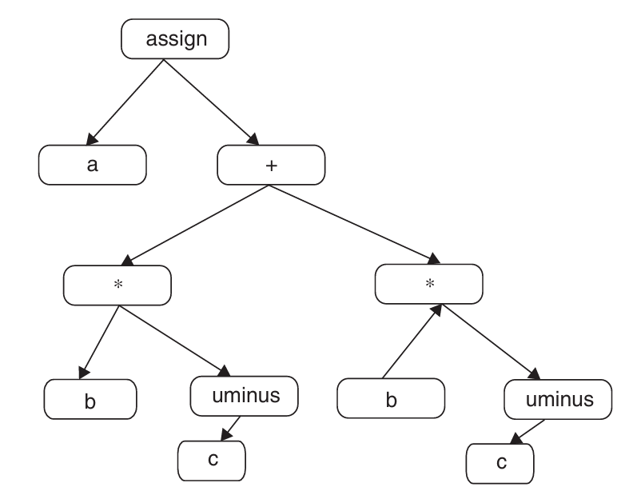
Consider the assignment a: = b* − c + b* − c. Draw the syntax tree

Slide 15
Types of Three Address Statement
The three address statements can be written in different standard formats and these formats are used based on the expression.
Assignment statements with binary operator
Assignment statements with unary operator
Copy statements
Unconditional Jumps
Conditional Jumps
Functional calls
Indexed assignments
Address assignments
Pointer assignment

Slide 16
Types of Three Address Statement
Assignment statements with binary operator
They are of the form A := B op C
where op is a binary arithmetic or logical operation.
2. Assignment statement with unary operator
Assignment statement x = op y
where op is a unary operation, e.g., unary minus, logical negation, shift operators

Slide 17
Types of Three Address Statement
3. Copy Statement
Copy statement x = y
where value of y is assigned to x
4. Unconditional Jump
The statement such as goto L:
The label L with three address statement is the next statement number to be executed.

Slide 18
Types of Three Address Statements
5. Conditional Jumps
if X relop Y goto L.
If the condition is satisfied, then this instruction applies a relational operator (<=,>=,) to X and Y and executes the statement with label L else the statement following if X relop Y goto L is executed.
6. Functional Calls
The functional calls are written as a sequence of param A, call fun, n , and return B statements, where A indicates one of the input argument in n arguments to be passed to the function fun that returns B. The return statement is optional.

Slide 19
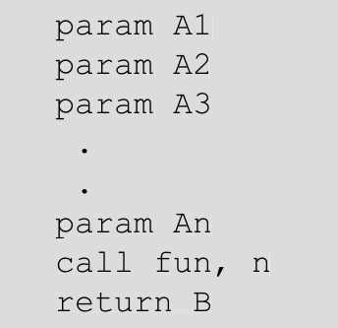

Example of Function Call
if the statement is B fun($A_{1},A_{2},A_{3},…,A_{n}$), then three address statements for it are as follows:

Slide 20
Indexed Assignment
The statements of the form A: = B[ i ] and A [ i ]: = B are indexed assignments.
In the A: = B[ i ] statement, A is set to the value in the location i memory units beyond location B.
A[i]:=B sets the contents of the location i units beyond A to the value of B. In both these instructions, A, B, and i refer to data objects.

Slide 21
Types of Three Address Statement
Address assignments
Statement of the form A:= &B, which sets A to the location B.
Pointer assignment
Statements of the form A:= *B and *A: = B are included.
For instance, A:= *B sets the value of A to the value pointed to by B. *A:=B changes the location of the value in A to the address pointed by B.

Slide 22
Example of each Statement
Type of Statement | Statement in C | Statement in TAC
Assignment Statements | x = a + b; | t1 = a + b x = t1
Assignment with Unary Operator | x = -a; | t1 = -a x = t1
Copy Statements | x = a; | x = a
Unconditional Jumps | goto L1; | goto L1
Conditional Jumps (if else) | if (a > b) goto L1; | if a > b goto L1
Function Calls | y = call func(x); | param x y = call func
Indexed Assignment | arr[i] = x; | t1 = i * width t2 = base + t1 *t2 = x
Address Assignment | p = &x; | p = &x
Pointer Assignment | x = *c; | t1 = *c x = t1

Slide 23
Representation of Three Address Code
Three address codes can be represented in special structures
Quadruple
triple
indirect triple.

Slide 24
Quadruple
A quadruple is a record structure with four fields.
First field is to store the operator, the second and third fields are for the operands used in the operation, and the fourth field is for the result. F.

Slide 25
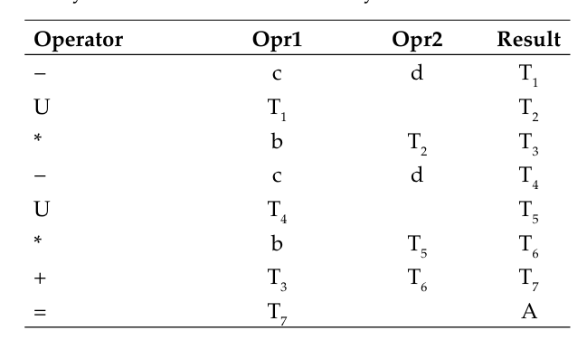
Example = a = b* − (c − d) + b* − (c − d)
We use U for unary minus and – as it is for binary minus.

Slide 26
Problem in Quadruple
In quadruples there is an overhead for managing the temporary variables created. This problem can be reduced by referring the position of the statement that computes the value of the sub expression.

Slide 27
Triple
In triples there are only three fields, one for the operation and the remaining two for operands that may have a variable or a constant or the statement position number that computes the value of the operand. Since there are only three fields, it is called “triples.”

Slide 28
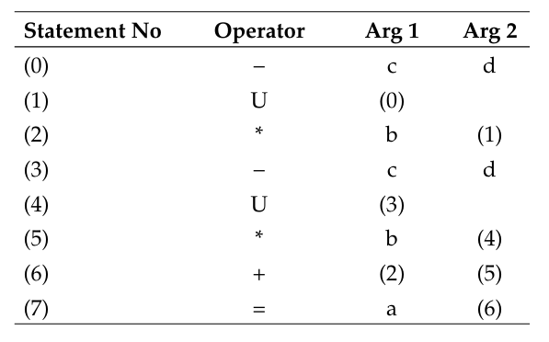
Example : a = b* − (c − d) + b* − (c − d)

Slide 29
Indirect Triples
Indirect triples consist of a listing of pointers to triples, rather than a listing of triples themselves.

Slide 30
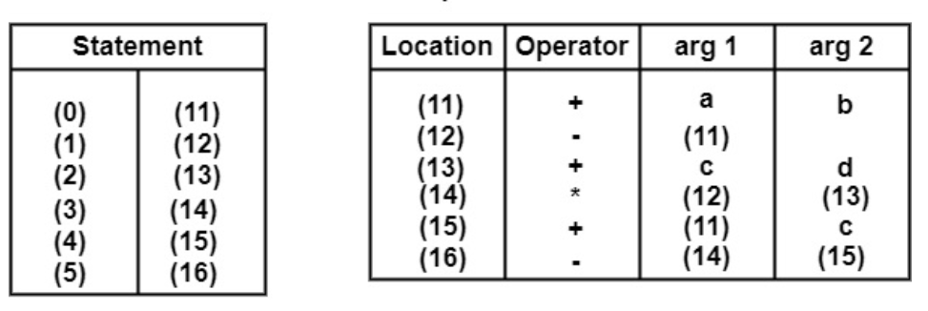
Example : (-(a+b)*(c+d))-((a+b)+c)

Slide 31
Syntax-Directed Translation into Three Address Code
Syntax-directed translation rules can be defined to generate the three address code while parsing the input.
It may be required to generate temporary names for interior nodes which are assigned to nonterminal E on the left side of the production E→E1 op E2.
While processing, the variable names and code generated so far are tracked till they reach the starting nonterminal.
For this purpose, we associate two attributes place and code associated with each nonterminal.

Slide 32
Assignment Statement
To generate intermediate code for assignment statement, first searching is applied to get the information of the identifier from the symbol table.
These identifiers are simple or multidimensional array or a constant value that is stored in a literal table.
After searching, the three address code is generated for the program statement.
Function lookup will search the symbol table for the lexeme and store it in id.place.
Function newtemp is defined to return a new temporary variable when invoked and gen function generates the code

Slide 33
Example:
Let us consider the example arithmetic statement a = − (b − c). When it is represented as three address code, the statements are
T1 = b − c
T2 = − T1
a = T2

Slide 34
Example:
While parsing the possible rules used for this expression are
S → id = E
E → − E
E → E − E
E → id

Slide 35
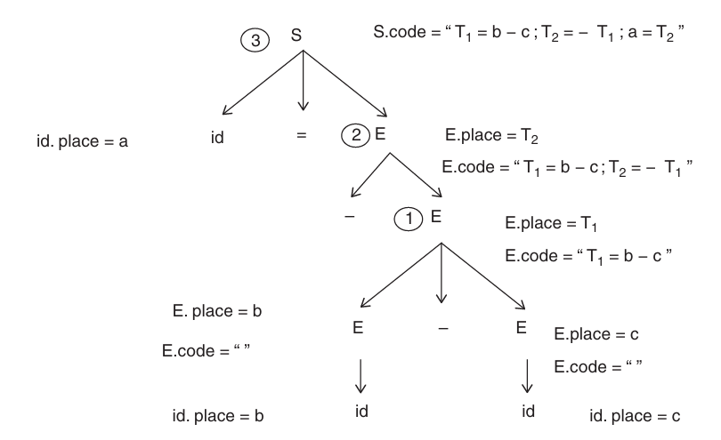
Syntax Tree

Slide 36
Solution
Consider the syntax tree for the expression a = −(b − c)
Step1:
Using the production E → id, that is, E → b and E → c.
Check for entries b and c in the symbol table; if these entries are not present an error message is displayed.
If these entries are present then E1 .place = b and E2 .place = c (pointer to symbol table for the entry b and c ).
Step2:
At node 1 in the figure using the production E → E1 − E2 it creates a temporary variable T1 using newtemp(). Three address code E.place = E1 .place + E2 .place is generated.

Slide 37
Solution:
Step3:
At node 2 in the fi gure using the production E → − E1 , it creates a temporary variable T2 using newtemp(). Three address code E.place = − E1 .place is generated.
Step4:
At node 3 using the production S → id = E searches for a in the symbol table, assuming it the code produced is a = E.place

Slide 38
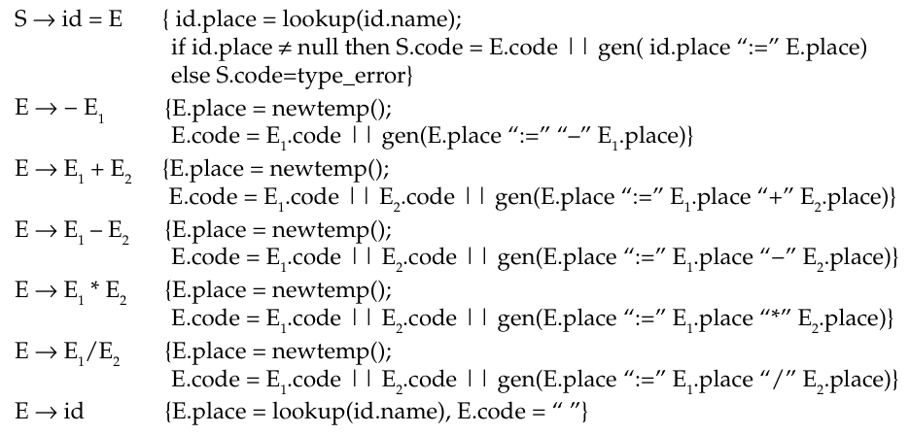
Type Checking
The syntax-directed translation for arithmetic statements can thus be written as follows:

